Slide 1
BHEEMISETTI YAMUNA
FINAL PROJECT
3/21/2024 Annual Review

Slide 2
PROJECT TITLE : keylogger and security
3/21/2024 Annual Review

Slide 3


AGENDA
Once installed, the keylogger monitors the keystrokes on the operating system you are using, checking the paths each keystroke goes through. In this way, a software keylogger can keep track of your keystrokes and record each one.
3/21/2024 Annual Review

Slide 4

PROBLEM STATEMENT
The problem statement is that the keyloggers can be detected using antiviruses. Installation of hardware keyloggers is difficult without the knowledge of the owner of the system. The solution to the above existing problem is that we can build a software keyloggers instead of hardware keyloggers.
3/21/2024 Annual Review

Slide 5
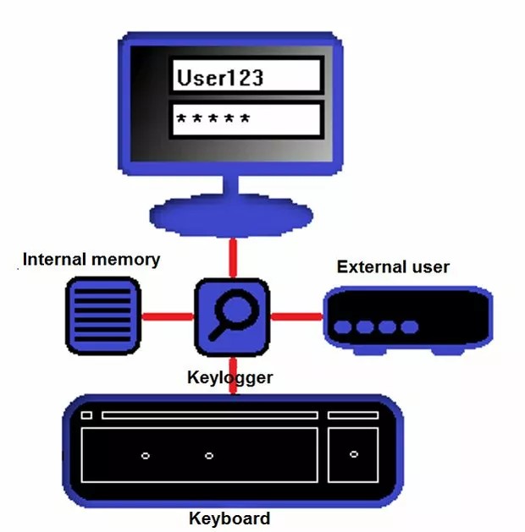

PROJECT OVERVIEW
A software keylogger is put on a computer when the user downloads an infected application. Once installed, the keylogger monitors the keystrokes on the operating system you are using, checking the paths each keystroke goes through. In this way, a software keylogger can keep track of your keystrokes and record each one.
3/21/2024 Annual Review

Slide 6


WHO ARE THE END USERS?
The end users of the keylogger project can vary based on their specific needs and use cases. Here are some common scenarios:
Employers and Managers: They can use keyloggers to monitor employee activity during work hours, ensuring productivity and preventing misuse of company resources.
Parents: Keyloggers help parents keep an eye on their children’s online activities, ensuring their safety and detecting any potential risks.
Individuals Concerned About Security: Anyone who wants to enhance their personal security can use keyloggers to detect unauthorized access or suspicious behavior.
3/21/2024 Annual Review

Slide 7

YOUR SOLUTION AND ITS VALUE PROPOSITION
The Keylogger project offers a powerful monitoring solution with a value proposition of enhanced security and risk detection. It allows you to track keystrokes, clipboard text, take screenshots at regular intervals, and even record audio. Keyloggers are useful for various purposes, such as monitoring employee activity, parental control, or securing sensitive information.
3/21/2024 Annual Review

Slide 8

THE WOW IN YOUR SOLUTION
Certainly! The keylogger project offers an impressive array of features that make it stand out:
Stealth Mode: It operates silently in the background, making it difficult for users to detect.
Comprehensive Monitoring: Tracks keystrokes, clipboard content, and captures screenshots.
Risk Detection: Helps identify potential security threats or unauthorized activities.
Customizable Settings: You can configure it to suit your specific monitoring needs.
3/21/2024 Annual Review
8

Slide 9
MODELLING
keyloggers, modeling refers to the techniques used to represent and capture keystrokes or other input events. Let’s explore how keyloggers work:
Software Keyloggers:
These are computer programs designed to steal passwords and other sensitive information from a victim’s computer.
Examples include:
JavaScript-based Keyloggers: Malicious scripts embedded in web pages that listen for key presses (e.g., oneKeyUp()).
Hardware Keyloggers:
These are independent of software and operate directly at the hardware level.
Examples include:
USB Keyloggers
3/21/2024 Annual Review
9

Slide 10
RESULTS
Certainly! In simple terms, the keylogger project is like a silent detective for your computer. It secretly watches what you type, records it, and keeps a log. Here’s why people use it:
Security: It helps detect unauthorized access or suspicious activity.
Parental Control: Parents can keep an eye on their kids’ online behavior.
Employee Monitoring: Employers use it to track work-related activities.
3/21/2024 Annual Review
10

